Slide 1
Operating System and
System Programming
Software College of SCU
四川大学软件学院 左航

Slide 2
Topics come from different perspective
Users’ perspective about heap: issues in using heap
  Wrapper( malloc and free)
  Memory leak
System’s perspective about heap: issues in manage heap
  Which blocks are occupied
  Which blocks are free and ready for next allocation
  Memory leak
201001V1.1

Slide 3
Unit 6. Memory Layout and Allocation
6.1 Several Uses of Memory
6.2 Memory Bugs
6.3 Garbage Collection
201001V1.1

Slide 4
6.3 Garbage Collection
6.3.0 Memory management mechanism (review)
6.3.1 Introduction
6.3.2 Classical GC algorithms
6.3.3 Summary
201001V1.1

Slide 5
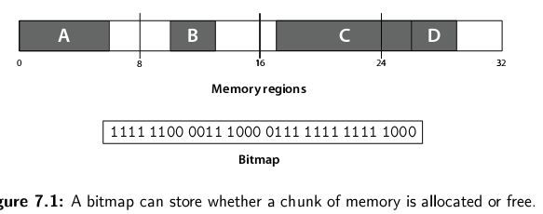
6.3.0 Memory management mechanism (review)(1/2)
How do we keep track of memory allocation?
  Use bitmap
    an array of bits, one per allocation chunk
201001V1.1

Slide 6
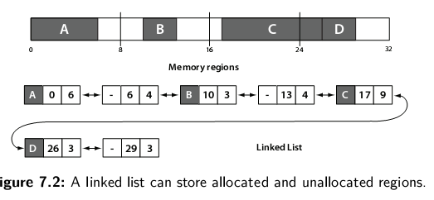
6.3.0 Memory management mechanism (review)(2/2)
How do we keep track of memory allocation?
  Use linked list
    stores contiguous regions of free or allocated memory.
length
start
201001V1.1

Slide 7
6.3 Garbage Collection
6.3.0 Memory management mechanism (review)
6.3.1 Introduction
6.3.2 Classical GC algorithms
6.3.3 Summary
201001V1.1

Slide 8
6.3.1 Introduction (1/10)
Dynamic Memory Management
  Explicit Memory Management (EMM)
  Automatic Memory Management (AMM)
201001V1.1

Slide 9
6.3.1 Introduction (2/10)
EMM: Keeping Track of Free Blocks
  Method 1: Implicit list using lengths -- links all blocks(隐式空闲链表)
5/0
4/1
6/0
2/1
201001V1.1
Notes:
Segregated free lists 隔离空闲链表

Slide 10
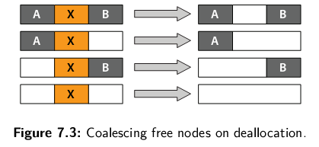
6.3.1 Introduction (3/10)
Deallocation: more details in textbook about footer
Coalesce合并:To combine two or more nodes into one.
Block size | 00a (1分配0空闲)
Payload 荷载
padding填充 可选
Block size | 00a
201001V1.1
Notes:
何时合并：刚释放还是等无法找到合适大小的空闲区域。立即导致反复合并分裂，而推迟合并更有效率。

Slide 11
6.3.1 Introduction (4/10)
EMM: Keeping Track of Free Blocks
  Method 2: Explicit list among the free blocks using pointers within the free blocks
    Typically doubly linked
5
4
6
2
A
B
C
201001V1.1

Slide 12
6.3.1 Introduction (5/10)
EMM
  Still need boundary tags(边界标记) for coalescing
  It is important to realize that links are not necessarily in the same order as the blocks
Forward links
A
B
4
4
4
4
6
6
4
4
4
4
C
Back links
201001V1.1

Slide 13
6.3.1 Introduction (6/10)
EMM: Keeping Track of Free Blocks
  Method 3: Segregated free lists (分离的空闲链表)
    Different free lists for different size classes
1-2
3
4
5-8
9-16
201001V1.1

Slide 14
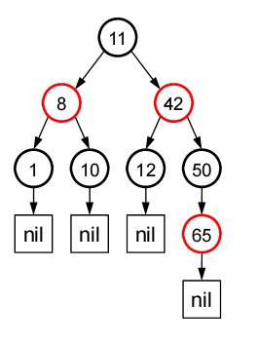
6.3.1 Introduction (7/10)
EMM: Keeping Track of Free Blocks
  Method 4: Blocks sorted by size
    Can use a balanced tree (e.g. Red-Black tree) with pointers within each free block, and the length used as a key
201001V1.1

Slide 15
6.3.1 Introduction (8/10)
Why Automatic Memory Management?
  Storage management is still a hard problem in modern programming
  C and C++ programs have many storage bugs
    forgetting to free unused memory
    dereferencing a dangling pointer
    overwriting parts of a data structure by accident
    and so on...
  Storage bugs are hard to find
    a bug can lead to a visible effect far away in time and program text from the source
201001V1.1

Slide 16
6.3.1 Introduction (9/10)
AMM: Garbage collection
  automatic reclamation of heap-allocated storage
  Implicit Memory Management -- application never has to free
  Lazy processing: blocks are reorganized only if needed
void foo() {
int *p = malloc(128);
return; /* p block is now garbage */
}
201001V1.1

Slide 17
6.3.1 Introduction (10/10)
AMM: Garbage collection
  Invented 1958 by John McCarthy for Lisp
  Common in functional languages, scripting languages, and modern object oriented languages:
    Lisp, Java, Perl, …
How to find those addresses pointed by discarded pointers?
201001V1.1

Slide 18
6.3 Garbage Collection
6.3.0 Memory management mechanism (review)
6.3.1 Introduction
6.3.2 Classical GC algorithms
6.3.3 Summary
201001V1.1

Slide 19
6.3.2 Classical GC algorithms
6.3.2.1 Basic concepts
6.3.2.2 Mark and sweep collection
6.3.2.3 Copying collection
6.3.2.4 Reference Counting
6.3.2.5 Generational garbage collection
201001V1.1

Slide 20
6.3.2.1 Basic concepts (1/2)
We view memory as a directed graph可达图
  Each block is a node in the graph
  Each pointer is an edge in the graph
  Locations not in the heap that contain pointers into the heap are called root nodes (e.g. registers, locations on the stack, global variables)
201001V1.1

Slide 21
6.3.2.1 Basic concepts (2/2)
Root nodes
Heap nodes
reachable
Not-reachable
(garbage)
A node (block) is reachable if there is a path from any root to that node. Non-reachable nodes are garbage (never needed by the application)
201001V1.1

Slide 22
6.3.2 Classical GC algorithms
6.3.2.1 Basic concepts
6.3.2.2 Mark and sweep collection
6.3.2.3 Copying collection
6.3.2.4 Reference Counting
6.3.2.5 Generational garbage collection
201001V1.1

Slide 23
6.3.2.2 Mark and Sweep Collecting (1/8)
Mark and Sweep Collecting 标记清除法(McCarthy, 1960)
  Can build on top of malloc/free package
    Allocate using malloc until you “run out of space”
  When out of space:
    Use extra mark bit in the head of each block
    Mark: Start at roots and sets mark bit on all reachable memory
    Sweep: Scan all blocks and free blocks that are not marked
  Conservative/保守的 Garbage Collector
    有些是Garbage，但是可能没有标识出来
201001V1.1
Notes:
9.10.3 最后一段

Slide 24
6.3.2.2 Mark and Sweep Collecting (2/8)
Mark bit set
root
Before mark
After mark
After sweep
free
free
201001V1.1

Slide 25
6.3.2.2 Mark and Sweep Collecting (3/8)
At the top level the algorithm in C, pseudocode looks as follows
void GC()
{
HaltAllProcessing();
ObjectCollection roots = GetRoots();
for(int i = 0; i < roots.Count(); ++i)
Mark(roots[i]);
Sweep();
}
It has three phases, enumeration of roots, marking all object references starting from the root and finally sweeping them.
201001V1.1

Slide 26
6.3.2.2 Mark and Sweep Collecting (4/8)
Root Enumeration
  The root enumeration lists all references held in registers, global or static fields, local variables on the stack, function arguments on stack, etc…
  The runtime system needs to provide ways for the GC to collect the list of roots.
    E.g. in the case of .NET maintains the information on the active roots and provides APIs to the GC to enumerate them.
201001V1.1

Slide 27
6.3.2.2 Mark and Sweep Collecting (5/8)
A conservative Mark and Sweep collector for C programs
  Is_ptr() determines if a word is a pointer by checking if it points to an allocated block of memory.
    last 2 bits are non-zero => can’t be a pointer (aligned)
    integer is not in allocated heap range => can’t be a pointer
  But in C, pointers can point to the middle of a block.
ptr
header
201001V1.1

Slide 28
6.3.2.2 Mark and Sweep Collecting (6/8)
So how do we find the beginning of the block?
  Can use balanced tree to keep track of all allocated blocks where the key is the location
  Balanced tree pointers can be stored in header (use two additional words)
head
data
size
left
right
201001V1.1
Notes:
平衡二叉树（Balanced Binary Tree）具有以下性质：它是一棵空树或它的左右两个子树的高度差的绝对值不超过1，并且左右两个子树都是一棵平衡二叉树。平衡二叉树的常用实现方法有红黑树、AVL、替罪羊树、Treap、伸展树等

Slide 29
6.3.2.2 Mark and Sweep Collecting (7/8)
Mark using depth-first (深度优先遍历) traversal of the memory graph
ptr mark(ptr p) {
if (!is_ptr(p)) return; // do nothing if not pointer
if (markBitSet(p)) return; // check if already marked
setMarkBit(p); // set the mark bit
for (i=0; i < length(p); i++) // mark all children
mark(p[i]);
return;
}
Sweep using lengths to find next block
ptr sweep(ptr p, ptr end) {
while (p < end) {
if markBitSet(p)
clearMarkBit();
else if (allocateBitSet(p))
free(p);
p += length(p);
}
201001V1.1
Notes:
图的深度优先遍历:类似于树的前序遍历。采用的搜索方法的特点是尽可能先对纵深方向进行搜索。

Slide 30
6.3.2.2 Mark and Sweep Collecting (8/8)
Advantage
  The advantage of mark and sweep is that you may never have to run it (it only runs when the heap is full).
  The other advantage is that it finds and frees all unused memory blocks.
Disadvantage
  Because the Mark and Sweep cycle locks out other processing while it runs, the GC can make a noticeable degradation in a programs performance.
201001V1.1

Slide 31
6.3.2 Classical GC algorithms
6.3.2.1 Basic concepts
6.3.2.2 Mark and sweep collection
6.3.2.3 Copying collection
6.3.2.4 Reference Counting
6.3.2.5 Generational garbage collection
201001V1.1

Slide 32
6.3.2.3 Copying collection (1/5)
Copying Collection 复制法
  Basic idea: use 2 heaps
    One used by program
    The other unused until GC time
  GC:
    Start at the roots & traverse横扫 the reachable data
    Copy reachable data from the active heap (from-space) to the other heap (to-space)
    Dead objects are left behind in from space
    Heaps switch roles
201001V1.1

Slide 33
6.3.2.3 Copying collection (2/5)
Copying Collection复制法
From-Space
To-Space
Roots
Set
201001V1.1

Slide 34
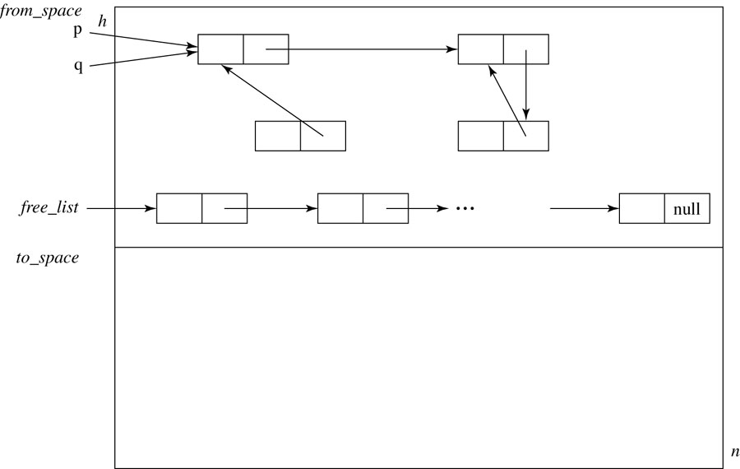
6.3.2.3 Copying collection (3/5)
Initial Heap Organization for Copy Collection
201001V1.1

Slide 35
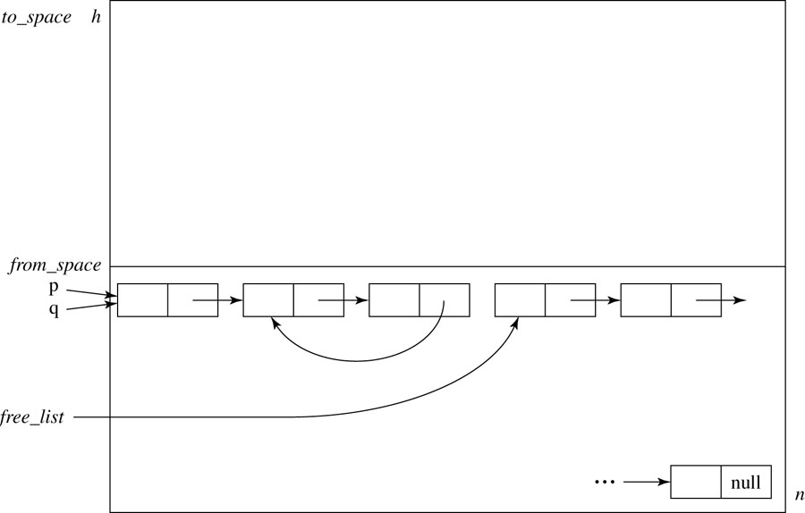
6.3.2.3 Copying collection (4/5)
Result of a Copy Collection Activation
201001V1.1

Slide 36
6.3.2.3 Copying collection (5/5)
The advantage of copy collection is that it is faster than mark and sweep.
  Because it makes only a single pass through the heap.
The main disadvantage is that you can only every use half of your heap space.
It also exhibits the unpredictable periodic interruptions that mark and sweep does.
201001V1.1

Slide 37
6.3.2 Classical GC algorithms
6.3.2.1 Basic concepts
6.3.2.2 Mark and sweep collection
6.3.2.3 Copying collection
6.3.2.4 Reference Counting
6.3.2.5 Generational garbage collection
201001V1.1

Slide 38
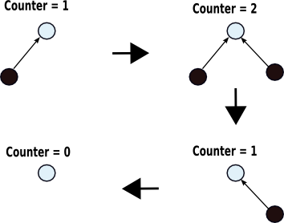
6.3.2.4 Reference Counting (1/5)
Reference Counting 引用计数法
  Keep track of the number of pointers to each object (the reference count).
  When the reference count goes to 0, the object is unreachable garbage
201001V1.1

Slide 39
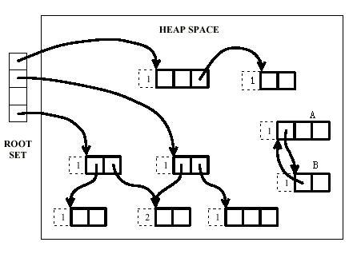
6.3.2.4 Reference Counting (2/5)
Reference Counting 引用计数法
201001V1.1

Slide 40
6.3.2.4 Reference Counting (3/5)
Reference Counting - problems
  Cost of reference counting
    Too many ref-count increments and decrements
  Fail to reclaim circular structures
    Not always effective
201001V1.1

Slide 41
6.3.2.4 Reference Counting (4/5)
Reference counting has the advantage of being dynamic, the algorithm is performed whenever there is an assignment or other heap action.
Disadvantages are:
  Inability to detect inaccessible circular lists.
  Overhead of keeping the counts (storage and time).
201001V1.1

Slide 42
6.3.2.4 Reference Counting (5/5)
Reference Counting 著名的应用案例
  微软的COM（Component Object Model）技术、使用ActionScript 3的FlashPlayer、Python语言以及在游戏脚本领域中被广泛应用的Squirrel中都使用了引用计数算法进行内存管理。但是，Java语 言中没有选用引用计数算法来管理内存，其中最主要的原因是它很难解决对象之间的相互循环引用的问题。
201001V1.1

Slide 43
6.3.2 Classical GC algorithms
6.3.2.1 Basic concepts
6.3.2.2 Mark and sweep collection
6.3.2.3 Copying collection
6.3.2.4 Reference Counting
6.3.2.5 Generational garbage collection
201001V1.1

Slide 44
6.3.2.5 Generational garbage collection (1/3)
Generational GC 分代式垃圾回收法
  Empirical(根据经验的)observation:
    If an object has been reachable for a long time, it is likely to remain so
  Empirical observation:
    In many languages, most objects died young
  Conclusion:
    we save work by scanning the young objects frequently and the old objects infrequently
201001V1.1
Notes:
对于代有一个形象的比喻：达尔文的进化论里有一段话：新生物种是最容易被逃汰的。比于内存而，新增的对象成为垃圾的可能性也是最大在的，而经过一次物种竞争的（GC过一次）生存的几率比较大。
代是增量GC的一种有效的手段，很多系统中都用到，代的数量和每一个代的大小也因不同的系统不同，传说中MS的代的大小是从asp.net统计分析得来的。这里要注意的是GC是惰性的，只要还有可用的空间，GC是不会启动的，这也是著名的连接漏洞形成的原因。

Slide 45
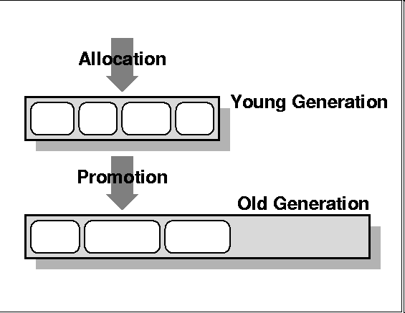
6.3.2.5 Generational garbage collection (2/3)
Generational GC
  Assign objects to different generations G0, G1,…
    G0 contains young objects, most likely to be garbage
    G0 scanned more often than G1
    Common case is two generations (new, tenured长期)
201001V1.1

Slide 46
6.3.2.5 Generational garbage collection (3/3)
Generational GC
  No need to traverse the entire reference tree
  Older generations are garbage collected infrequently
  The youngest generation can be collected in 5 to 50ms (ms stands for milliseconds, 1ms = 0.001 seconds).
  The youngest generation, which is where most of the work is done, contains the highest proportion of garbage. By focusing the work here, the overall system is more efficient.
  Qualified to be Old or yang ?
201001V1.1

Slide 47
6.3 Garbage Collection
6.3.0 Memory management mechanism (review)
6.3.1 Introduction
6.3.2 Classical GC algorithms
6.3.3 Summary
201001V1.1

Slide 48
6.3.3 Summary(1/7)
引用计数是解决显式内存分配问题的常用解决方案。实现赋值时递增和递减操作的代码通常是程序缓慢的原因之一。无论如何，引用计数也不是全面的解决方案，因为循环引用从不会被删除。
内存管理代码总量会变少。程序越大，它在cache中的部分越少；它的调页越多，它运行的越慢.
垃圾回收只会在内存变得紧张时才会运行。当内存尚且宽裕时，程序将全速运行，不会在释放内存上花费任何时间。
相对于过去的缓慢的垃圾回收程序，现代的垃圾回收程序要先进得多。分代, 复制回收程序在很大程度上克服了早期的标记&清除算法的低效。
201001V1.1

Slide 49
6.3.3 Summary(2/7)
现代垃圾回收程序进行堆紧缩。堆紧缩将减少程序引用的页的数量，这意味着内存访问命中率将更高，交换将更少。
采用垃圾回收的程序不会因为内存泄漏的累积而崩溃。采用 GC 的程序拥有更长期的稳定性。采用GC的程序 有更少的难以发现的指针错漏。 这是因为指向已经释放的
内存的悬挂指针被系统自动侦测并释放。
采用垃圾回收的程序的开发和调试更快，因为不用开发、调试、测试或维护显式的释放代码
Automatic garbage collection can't be used with C and C++. Not true. It is possible to "plug in" a conservative garbage collector in your C or C++ program, giving fast and reliable automatic memory management.
201001V1.1
Notes:
堆紧缩即合并空闲区域

Slide 50
6.3.3 Summary(3/7)
垃圾回收并非什么仙丹妙药。它有着以下不足：
  内存回收何时运行是不可预测的，所以程序可能意外暂停。
    运行内存回收的时间是没有上界的。尽管在实践中它的运行通常很快，但无法保证这一点。
    除了回收程序以外的所有线程在回收进行时都会停止运行。
  垃圾回收程序也许会留下一些本该回收的内存。在实践中，这不是什么大问题，因为显式内存回收程序通常会泄露一些内存，这致使它们最终耗尽所有内存，另一个理由就是显式内存回收程序通常会把内存放回自己的内部内存池中而不是把内存交还给操
  作系统。
  垃圾回收应该被实现为一个基本的操作系统内核服务。但是因为现实并非如此，就造成了采用垃圾回收的程序被迫带着它们的垃圾回收实现到处跑。尽管这个实现可以被做成一个共享 DLL ，它也还是程序的一部分。
201001V1.1

Slide 51
6.3.3 Summary(4/7)
垃圾收集算法评价标准：
* 暂停时间。收集器是否停止所有工作来进行垃圾收集？要停止多长时间？暂停是否有时间限制？
* 暂停的可预测性。垃圾收集暂停是否规划为在用户程序方便而不是垃圾收集器方便的时间发生？
* CPU 占用。总的可用 CPU 时间用在垃圾收集上的百分比是多少？
* 内存大小。许多垃圾收集算法需要将堆分割成独立的内存空间，其中一些空间在某些时刻对用户程序是不可访问的。这意味着堆的实际大小可能比用户程序的最大堆驻留空间要大几倍。
201001V1.1

Slide 52
6.3.3 Summary(5/7)
* 虚拟内存交互。在具有有限物理内存的系统上，一个完整的垃圾收集在垃圾收集过程中可能会错误地将非常驻页面放到内存中来进行检查。因为页面错误的成本很高，所以垃圾收集器正确管理引用的区域性 (locality) 是很必要的。
* 缓存交互。即使在整个堆可以放到主内存中的系统上 ―― 实际上几乎所有 Java 应用程序都可以做到这一点，垃圾收集也常常会有将用户程序使用的数据冲出缓存的效果，从而影响用户程序的性能。
* 对程序区域性的影响。虽然一些人认为垃圾收集器的工作只是收回不可到达的内存，但是其他人认为垃圾收集器还应该尽量改进用户程序的引用区域性。整理收集器和复制收集器在收集过程中重新安排对象，这有可能改进区域性。
* 编译器和运行时影响。一些垃圾收集算法要求编译器或者运行时环境的重要配合，如当进行指针分配时更新引用计数。这增加了编译器的工作，因为它必须生成这些簿记指令，同时增加了运行时环境的开销，因为它必须执行这些额外的指令。这些要求对性能有什么影响呢？它是否会干扰编译时优化呢？
201001V1.1

Slide 53
6.3.3 Summary(6/7)
不管选择什么算法，硬件和软件的发展使垃圾收集更具有实用性。20 世纪 70 和 80 年代的经验研究表明，对于大型 Lisp 程序，垃圾收集消耗 25％ 到 40％ 的运行时。垃圾收集还不能做到完全不可见，这肯定还有很长的路要走。
201001V1.1

Slide 54
6.3.3 Summary (7/7)
Reference
  Garbage Collection in the Java HotSpot Virtual Machine, by Tony Printezis (See file: hotspot-gc.pdf)
  Wikipedia on Garbage Collection (http://en.wikipedia.org/wiki/Garbage_collection_%28computer_science%29)
201001V1.1

Slide 55
Lab: Implementing a Conservative Garbage Collector
1. splay tree
2. simple process
  about gc_malloc
  conservative garbage collector
201001V1.1
201001V1.1

Slide 56
1. splay tree (1/10)
Concept
  A splay tree伸展树分裂树 is a self-adjusting binary search tree (BST) with the additional property that recently accessed elements are quick to access again.
    adjust tree in response to accesses to make common operations efficient
    after access node is moved to root by splaying
Performance
  Amortized分摊 such that 1 operations take O(lg n) where n is the number of nodes
201001V1.1

Slide 57
1. splay tree (2/10)
Splay Operation
  Traverse tree from node x to root, rotating along the way until x is the root
  Each rotation
    If x is root, do nothing.
    If x has no grandparent, rotate x about its parent.
    If x has a grandparent,
      if x and its parent are both left children or both right children, rotate the parent about the grandparent, then rotate x about its parent
      if x and its parent are opposite type children (one left and the other right), rotate x about its parent, then rotate x about its new parent (former grandparent)
201001V1.1

Slide 58
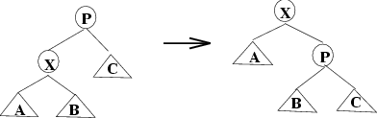
1. splay tree (3/10)
Node has no grandparent
201001V1.1

Slide 59
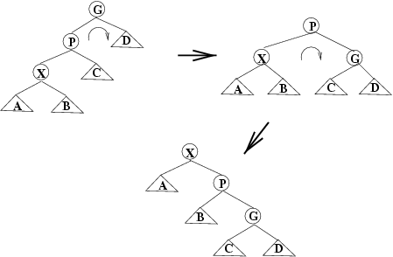
1. splay tree (4/10)
Node and Parent are Same Side: Zig-Zig
201001V1.1

Slide 60
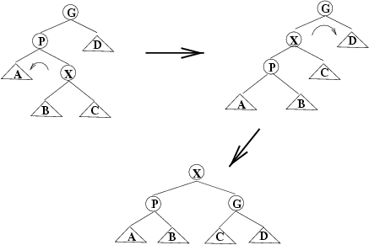
1. splay tree (5/10)
Node and Parent are Different Sides: Zig-Zag
201001V1.1

Slide 61
1. splay tree (6/10)
Operations in Splay Trees
  insert
    first insert as in normal binary search tree
    then splay inserted node
    if there is a duplicate, the node holds the duplicate element is splayed
  find
    search for node
    if found, splay to root; otherwise splay last node on path
201001V1.1

Slide 62
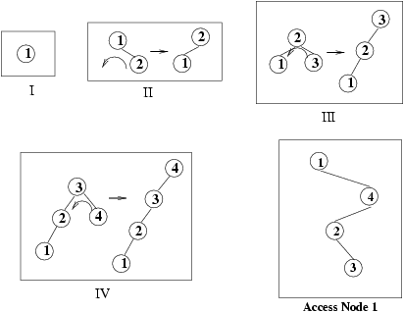
1. splay tree (7/10)
Insertion in order into a Splay Tree
201001V1.1

Slide 63
1. splay tree (8/10)
Operations on Splay Trees (cont.)
  remove
    splay selected element to root
    disconnect left and right subtrees from root
    do one of:
      splay max item in T_{L} (then T_{L} has no right child)
      splay min item in T_{R} (then T_{R} has no left child)
    after deletion, we splay the parent of the removed node to the top of the tree
201001V1.1

Slide 64
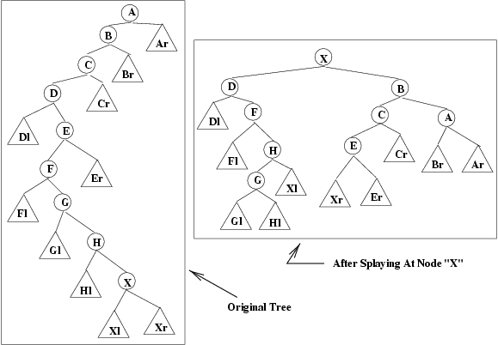

1. splay tree (9/10)
201001V1.1

Slide 65
1. splay tree (10/10)
Performance of Splay Trees
  insert
    regular BST insertion -- O(depth)
    splay: O(1) for each rotation, O(depth) rotations
201001V1.1

Slide 66
References:
Linux heap 管理
  https://sploitfun.wordpress.com/2015/02/10/understanding-glibc-malloc/comment-page-1/
201001V1.1

Slide 67
Lab: Implementing a Conservative Garbage Collector
1. splay tree
2. simple process
  about gc_malloc
  conservative garbage collector
201001V1.1
201001V1.1

Slide 68
2. simple process (1/2)
1/ Initialize heap
  Apply heap
  Free list head pointer (lower performance)
  allocated tree head pointer
2/ gc_malloc
  Any free block fit
    Yes:Gc_remove_free
    No: sbrk: ask for more page
  Insert in allocated tree
  Remainder insert in free list
201001V1.1

Slide 69
2. simple process (2/2)
3/ gc_collect
  Find root
  mark
  collect_unmark and push to self-defined stack
  ( Coalesce or not)
  gc_add_free
  Verify_complete()
When to call gc_collect: lazy
201001V1.1

